Slide 1

Rockbuster LLC Analysis

Slide 2

Our Analysis will cover the following:
● The most popular genre?
● Which movies contributed the most/least to revenue gain?
● What was the average rental duration for all videos?
● Which countries are Rockbuster customers based in?
● Do sales figures vary between geographic regions?
● Where are customers with a high lifetime value based?

Slide 3

The most popular Movies Genre?

Slide 4
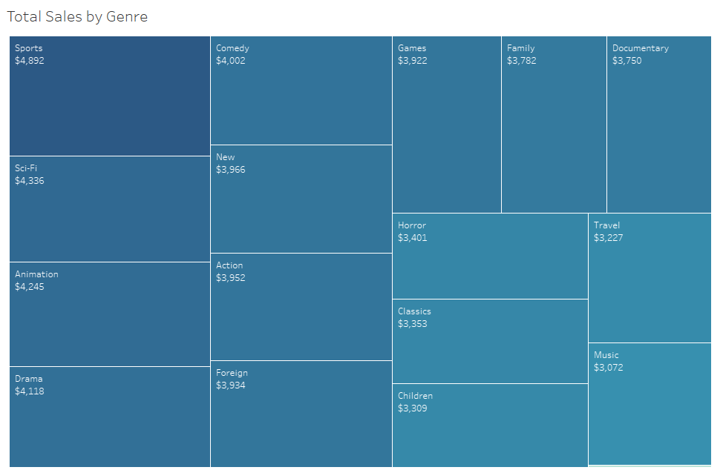


Slide 5

Which movies contributed the most/least to revenue gain

Slide 6
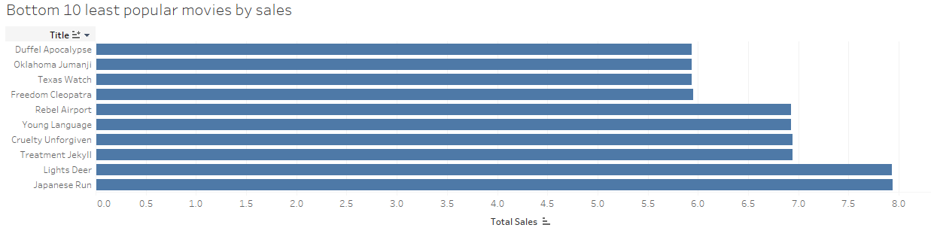
Movies that contribute the least in our sales figure:

Slide 7
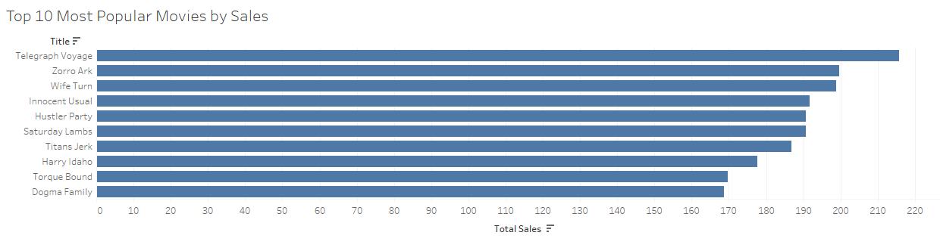
Top 10 Movies that contributes the most in our sales figure:

Slide 8



What was the average rental duration for all videos?
Rental Duration
Average: 5 Days
Max: 7 Days
Min: 3 Days

Slide 9

Rockbuster customer and sales figure worldwide

Slide 10
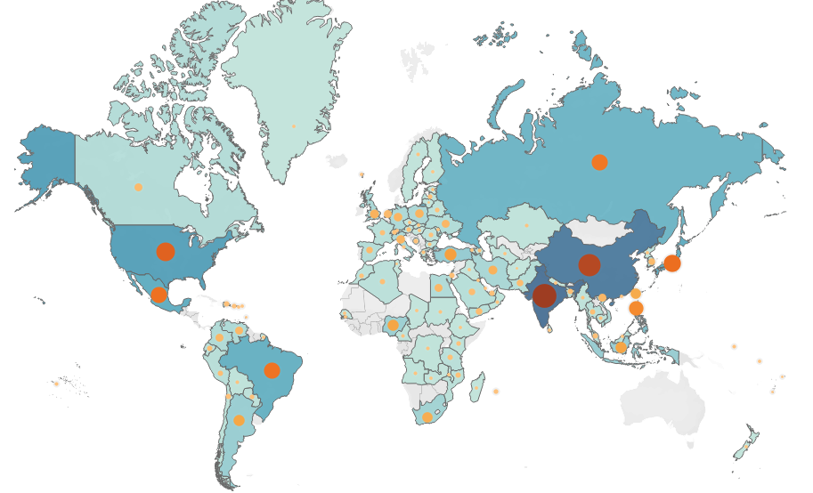


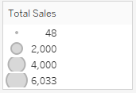
Figure 1. Map shows all the number of Rockbuster customer and sales figure worldwide

Slide 11
Summary from the previous Map:
Country | Total Sales | The Number of Customers
India | $ 6,032.79 | 1421
China | $ 5,247.04 | 1296
United States | $ 3,694.27 | 873
Japan | $ 3,121.52 | 748
Mexico | $ 2,984.82 | 718
Brazil | $ 2,919.19 | 681
Russian Federation | $ 2,765.62 | 638
Philippines | $ 2,219.70 | 530
Turkey | $ 1,498.49 | 351
Indonesia | $ 1,352.69 | 331

Slide 12

Customers with high lifetime valued based
Customer Id | First Name | Last Name | Country | City | Total Amount
566 | Casey | Mena | Turkey | Tokat | $130.68
84 | Sara | Perry | Mexico | Atlixco | $128.7
506 | Leslie | Seward | Indonesia | Pontianak | $123.72
389 | Alan | Kahn | China | Emeishan | $119.75
537 | Clinton | Buford | United States | Aurora | $98.76

Slide 13






Suggestion:
1. I would suggest removing movies that contribute to the least sales figure. We can replace these movies according to the top 4 movies genre. If we keep films that contribute to the least sales figure, this would be a dead stock and these movies aren’t generating any cash flow.
2. Secondly, we should push the marketing effort and budget based on the number of customers and the total sales of that region. The higher the sales, and the number of customer, the higher the marketing effort should be. At the same time, we should give more incentive to our most loyal customers.
3. Lastly, due to exponential growth in digital devices. I would suggest doing further analysis on slowly moving their services to streaming services to compete with the current trend.

Slide 14
Tableau URL
https://public.tableau.com/app/profile/valens.sulaiman/viz/Exercise3_10_16364843694450/TotalSalestreemap?publish=yes

